Slide 1
Operator Overloading

Slide 2
Operator Overloading
C++ has the ability to provide the operators with the special meaning for a data type.
The mechanism of giving such special meanings to an operator is known as Operator overloading.
It provides a flexible option for creation of new definitions for most of C++ operators.
Operator Overloading is a specific case of polymorphism in which some or all of operators like +, =, or == have different implementations depending on the types of their arguments.

Slide 3
Contt….
We can overload all C++ operators except the following:
Class member access operator(. , .*)
Scope resolution operators(::)
Size operator( sizeof)
Conditional operators(?:)

Slide 4
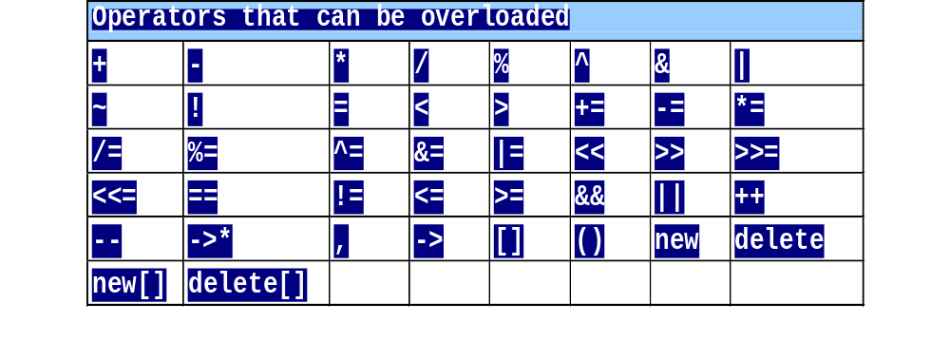
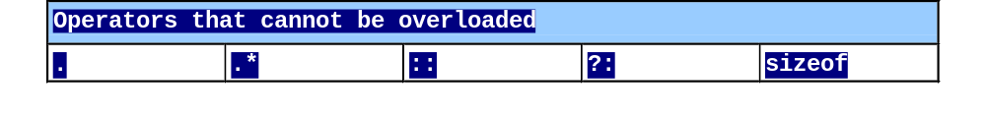
Restrictions on Operator Overloading

Slide 5
Fundamentals of Operator Overloading
  Cannot create new operators
    Semantics of an operator can be extended but syntax cannot be changed.
Overloading operators
  Create a function for the class
  Name function operator followed by symbol
    Operator+ for the addition operator +

Slide 6
Restrictions on Operator Overloading
Cannot change
  How operators act on built-in data types
    i.e., cannot change integer addition
    When an operator is overloaded original meaning is not changed.
    For eg: + operator can be used to add two vectors but it can also used to add two integers.
  Number of operands
    & is unary, only acts on one operand

Slide 7
Restrictions on Operator Overloading
Cannot create new operators
Operators must be overloaded explicitly
  Overloading + does not overload +=

Slide 8
Syntax
return_type operator # (argument list)
{………..}
Eg-
complex operator +(complex);
void operator >(distance);

Slide 9
First of all we must specify the class to which the operator is applied.
Function used for this is called operator function.
return-type classname:: operator op(arglist)
{
function body;
}

Slide 10
Steps in process of overloading
Create a class that defines data types that is to be used in the overloading operation.
Declare the operator function operator op() in public part of the class.
Define the function to implement the required operation.

Slide 11
Types of Operator Overloading
Unary Operator Overloading
Binary Operator Overloading
Operator function → Type of overloading ↓ | Member function | Friend function
Unary operator | Zero arguments in operator function | One argument in operator function
Binary Operator | One argument in operator function | Two arguments in operator function
Notes:
Student Book

Slide 12
Unary Operator Overloading
It is defined by either a member function that takes no parameter or a non-member function that takes one parameter
Example:
i1.operator -()
or
operator -(i1)
or
-i1

Slide 13
Example of Unary operator overloading using member function
class space
{
int x, y, z;
public:
space(int a, int b, int c)
{
x=a;
y=b;
z=c;
}
void display()
{
cout<<x<<endl;
cout<<y<<endl;
cout<<z<<endl;
}
void operator-()
{
x=-x;
y=-y;
z=-z;
}
}; //end of class definition
int main()
{
space s(10,-20,30);
cout<<"s :";
s.display();
-s; // OR s.operator-();
cout<<"-s :";
s.display();
return 0;
}

Slide 14
Example of Unary operator overloading using friend function
class space
{
int x, y, z;
public:
space(int a, int b, int c)
{
x=a;
y=b;
z=c;
}
void display()
{
cout<<x<<endl;
cout<<y<<endl;
cout<<z<<endl;
}
friend void operator-(space &s);
}; //end of class definition
void operator-(space &s)
{
s.x = -s.x;
s.y = -s.y;
s.z = -s.z;
}
int main()
{
space s(10,-20,30);
cout<<"s :";
s.display();
-s; // OR operator-(s);
cout<<"-s :";
s.display();
return 0;
}

Slide 15
Binary Operator Overloading
It is defined by either a member function that takes one parameter or a non-member function that takes two parameters.
Example:
c3 = c1.operator +(c2)
or
c3 = operator +(c1,c2)
or
c3 = c1 + c2

Slide 16
Types of Operator Overloading
Unary Operator Overloading
Binary Operator Overloading
Operator function → Type of overloading ↓ | Member function | Friend function
Unary operator | Zero arguments in operator function | One argument in operator function
Binary Operator | One argument in operator function | Two arguments in operator function
Notes:
Student Book

Slide 17
Example of Binary operator overloading using member function
class complex
{
int x, y;
public:
complex() { } // default constructor
complex(int a, int b)
{
x=a;
y=b;
}
void display()
{
cout<<x<<endl;
cout<<y<<endl;
}
complex operator + (complex &obj)
{
complex temp;
temp.x = x + obj.x;
temp.y = y + obj.y;
return temp;
}
}; //end of class definition
int main()
{
complex c1(15,30);
complex c2(20,35);
complex c3;
c3 = c1+c2 ; // or c3 = c1.operator+(c2);
c3.display();
return 0;
}

Slide 18
Example of Binary operator overloading using friend function
class complex
{
int x, y;
public:
complex() { } // default constructor
complex(int a, int b)
{
x=a;
y=b;
}
void display()
{
cout<<x<<endl;
cout<<y<<endl;
}
friend complex operator+(complex &obj1, complex &obj2);
}; //end of class definition
complex operator + (complex &obj1, complex &obj2)
{
complex temp;
temp.x = obj1.x + obj2.x;
temp.y = obj1.y + obj2.y;
return temp;
}
int main()
{
complex c1(15,30);
complex c2(20,35);
complex c3;
c3 = c1+c2 ; // or c3 = operator+(c1,c2);
c3.display();
return 0;
}

Slide 19
Rules for overloading operators.
Only existing operators can be overloaded. New operators cannot be created.
The overloaded operator must have at least one operand that is of user defined type.
We cannot change the basic meaning of the operator.
Overloaded operators follow the syntax rules of the original operators. They cannot be overridden.

Slide 20
Rules for overloading operators.
There are some operators that cannot be overloaded.
Unary operators overloaded by means of member function, take no explicit arguments and return no explicit values.
Binary operators overloaded through a member function take ONE explicit argument.
When using binary operators overloaded through a member function, the left hand operand must be an object of the relevant class.
Let’s move to an example……..
How ???

Slide 21
Example: s2 = s1 + 10;
complex operator + ( int m)
{
complex temp;
temp.x = x + 10;
temp.y = y + 10;
return temp;
}

Slide 22
Example
class complex
{
int x, y;
public:
complex() { } // default constructor
complex(int a, int b)
{
x=a;
y=b;
}
void display()
{
cout<<x<<endl;
cout<<y<<endl;
}
complex operator + ( int m)
{
complex temp;
temp.x = x + m;
temp.y = y + m;
return temp;
}
}; //end of class definition
int main()
{
complex c1(15,30);
complex c2;
c2 = c1+ 10 ; // or c2 = c1.operator+(10);
c2.display();
return 0;
}

Slide 23
Type conversion

Slide 24
Type Conversion
There are four types of situation that might arise in the type conversion:
  Conversion from basic type to basic type
  Conversion from basic type to class type
  Conversion from class type to basic type
  Conversion from class type to class type
Notes:
Student Book
This is a powerful feature of the C++ language. It requires care, otherwise it can create ambiguity as to which type to convert to.

Slide 25
1. Basic type to basic type
int x;
float y=10.00;
x=y;

Slide 26
2. basic type to class type
In order to convert basic data type to class type, there must be a parameterized constructor present in the program that helps in conversion. That constructor will have one argument of the basic data type that needs to converted to class type
Let us suppose there is a class “time” having hrs and mins as data members. Let us read an integer from the user. The objective is to convert that integer ( basic type) into hrs and mins (class type)
i.e. Converting 85 into 1 hour and 25 minutes

Slide 27
Program
int main()
{
int x;
cout<<"Enter any integer"<<endl;
cin>>x;
time T;
T = x; // Basic to class type
T.display();
return 0;
}
class time
{
int hrs, mins;
public:
time(){}
time(int m) //parameterized constructor
{
hrs=m/60;
mins = m%60;
}
void display()
{
cout<<" The hours are "<<hrs<<endl;
cout<<" The minutes are "<<mins<<endl;
}
};

Slide 28
3. class type to basic type
In order to convert class type to basic type, there must be operator function present in the program that helps in conversion. That operator function should satisfy following conditions
  It must be a class member
  It must not specify return type
  It must not have any arguments
Let us suppose there is a class “time” having hrs and mins as data members. Let us read hrs and mins from the user. The objective is to convert that hrs and mins (class type) to integer ( basic type)
i.e. Converting 2 hours and 20 minutes into 140

Slide 29
Program
int main()
{
time T;
T.getdata();
int x;
x = T; // Class to Basic Type
cout<<" The integer value is"<<x<<endl;
return 0;
}
class time
{
int hrs,mins;
public:
void getdata()
{
cout<<"Enter the value of hours and mins"<<endl;
cin>>hrs>>mins;
}
operator int()
{
int m;
m = hrs*60 + mins;
}
};

Slide 30
4. class type to class type
In order to convert class type to another class type, the source class has the constructor function present in it and the destination class has operator function present in it.

Slide 31
class Minute
{
int min;
public:
Minute()
{
min = 0;
}
void operator=(Time T)
{
min=T.getMinutes();
}
void display()
{
cout<<"\n Total Minutes : " <<min<<endl;
}
};
int main()
{
Time t1(2,30);
t1.display();
Minute m1;
m1.display();
m1 = t1; // conversion from Time to Minute
t1.display();
m1.display();
}
class Time
{
int hrs,min;
public:
Time(int h,int m)
{
hrs=h;
min=m;
}
Time()
{
cout<<"\n Time's Object Created";
}
int getMinutes()
{
int tot_min = ( hrs * 60 ) + min ;
return tot_min;
}
void display()
{
cout<<"Hours: "<<hrs<<endl ;
cout<<" Minutes : "<<min <<endl ;
}
};
C++ function call by reference. The call by reference method of passing arguments to afunction copies the reference of an argument into the formal parameter. Inside the function, thereference is used to access the actual argument used in the call.

Slide 32
C++ function call by reference. The call by reference method of passing arguments to a function copies the reference of an argument into the formal parameter. Inside the function, the reference is used to access the actual argument used in the call.

Slide 33
Thanks

